Slide 1

Inject 7
Physical and Infrastructure Effects Briefing
August 27, 2022
2015 PDC
Mark Boslough & Barbara Jennings
Sandia National Labs
Albuquerque, NM
Bill Fogleman, GRIT – Mapping
Paul Chodas – JPL - Trajectory
Souheil Ezzedine – LLNL – Tsunami
EXERCISE
Sandia is a multiprogram laboratory operated by Sandia Corporation, a Lockheed Martin Company,
for the United States Department of Energy under contract DE-AC04-94AL85000.
Notes:
August 1972 fireball over western US

Slide 2
What we have been told
Deflection partially successful
Entry speed: 16 km/s (36,000 mph, ~mach 47)
Elevation angle is ~36° from horizontal
Coming from southeast (~ 36° south of east)
Size: 80 meters in diameter
Composition: Stone, density 3.3 g/cm³
18 - 25 Megaton impact expected
Impact is certain: September 3, 2022

Slide 3
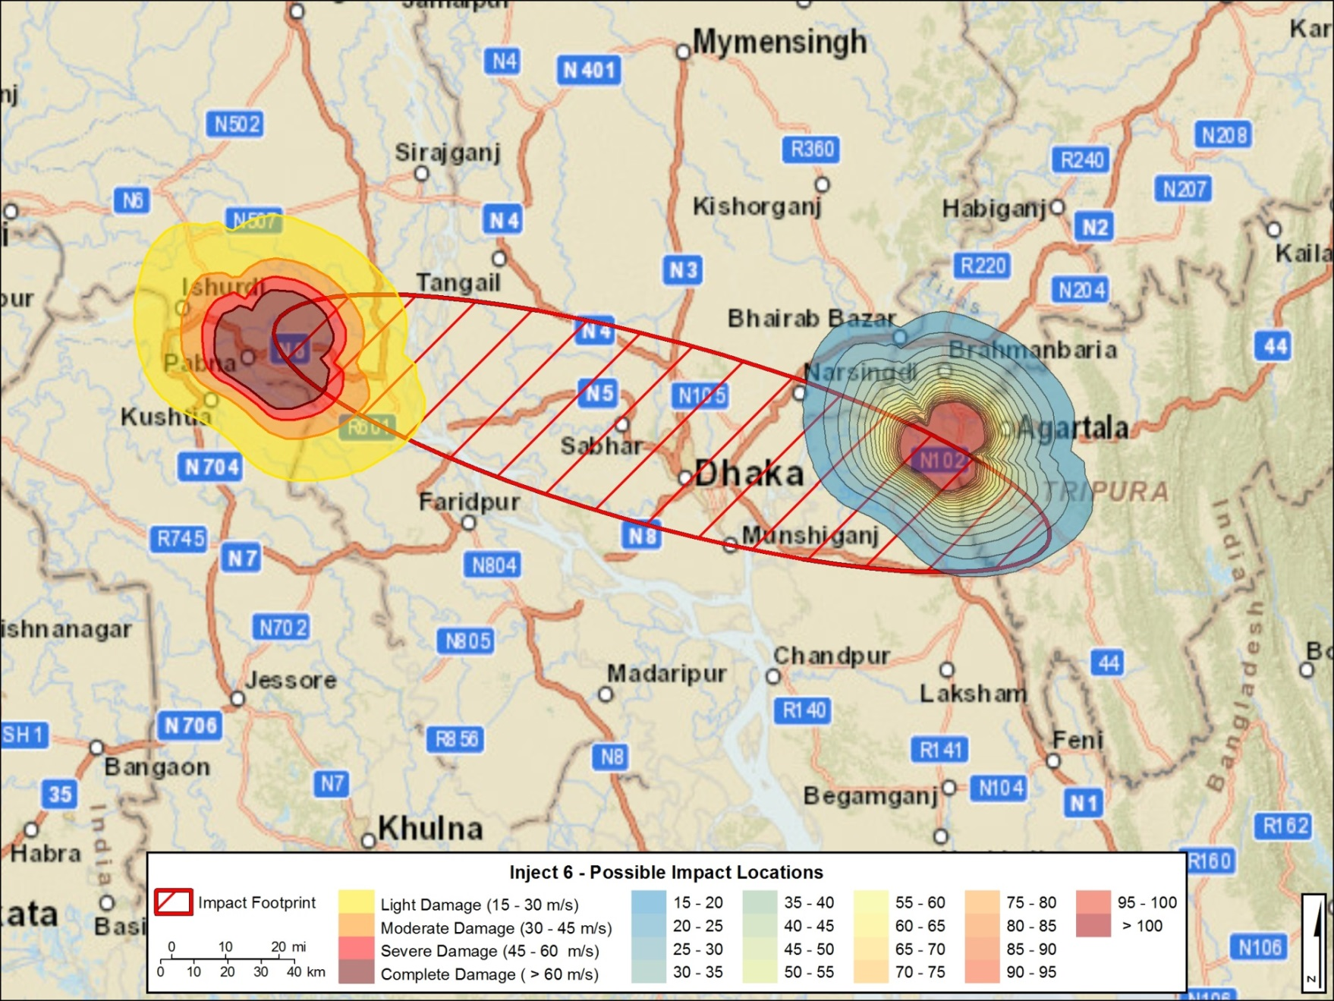
Last footprint before radar data

Slide 4
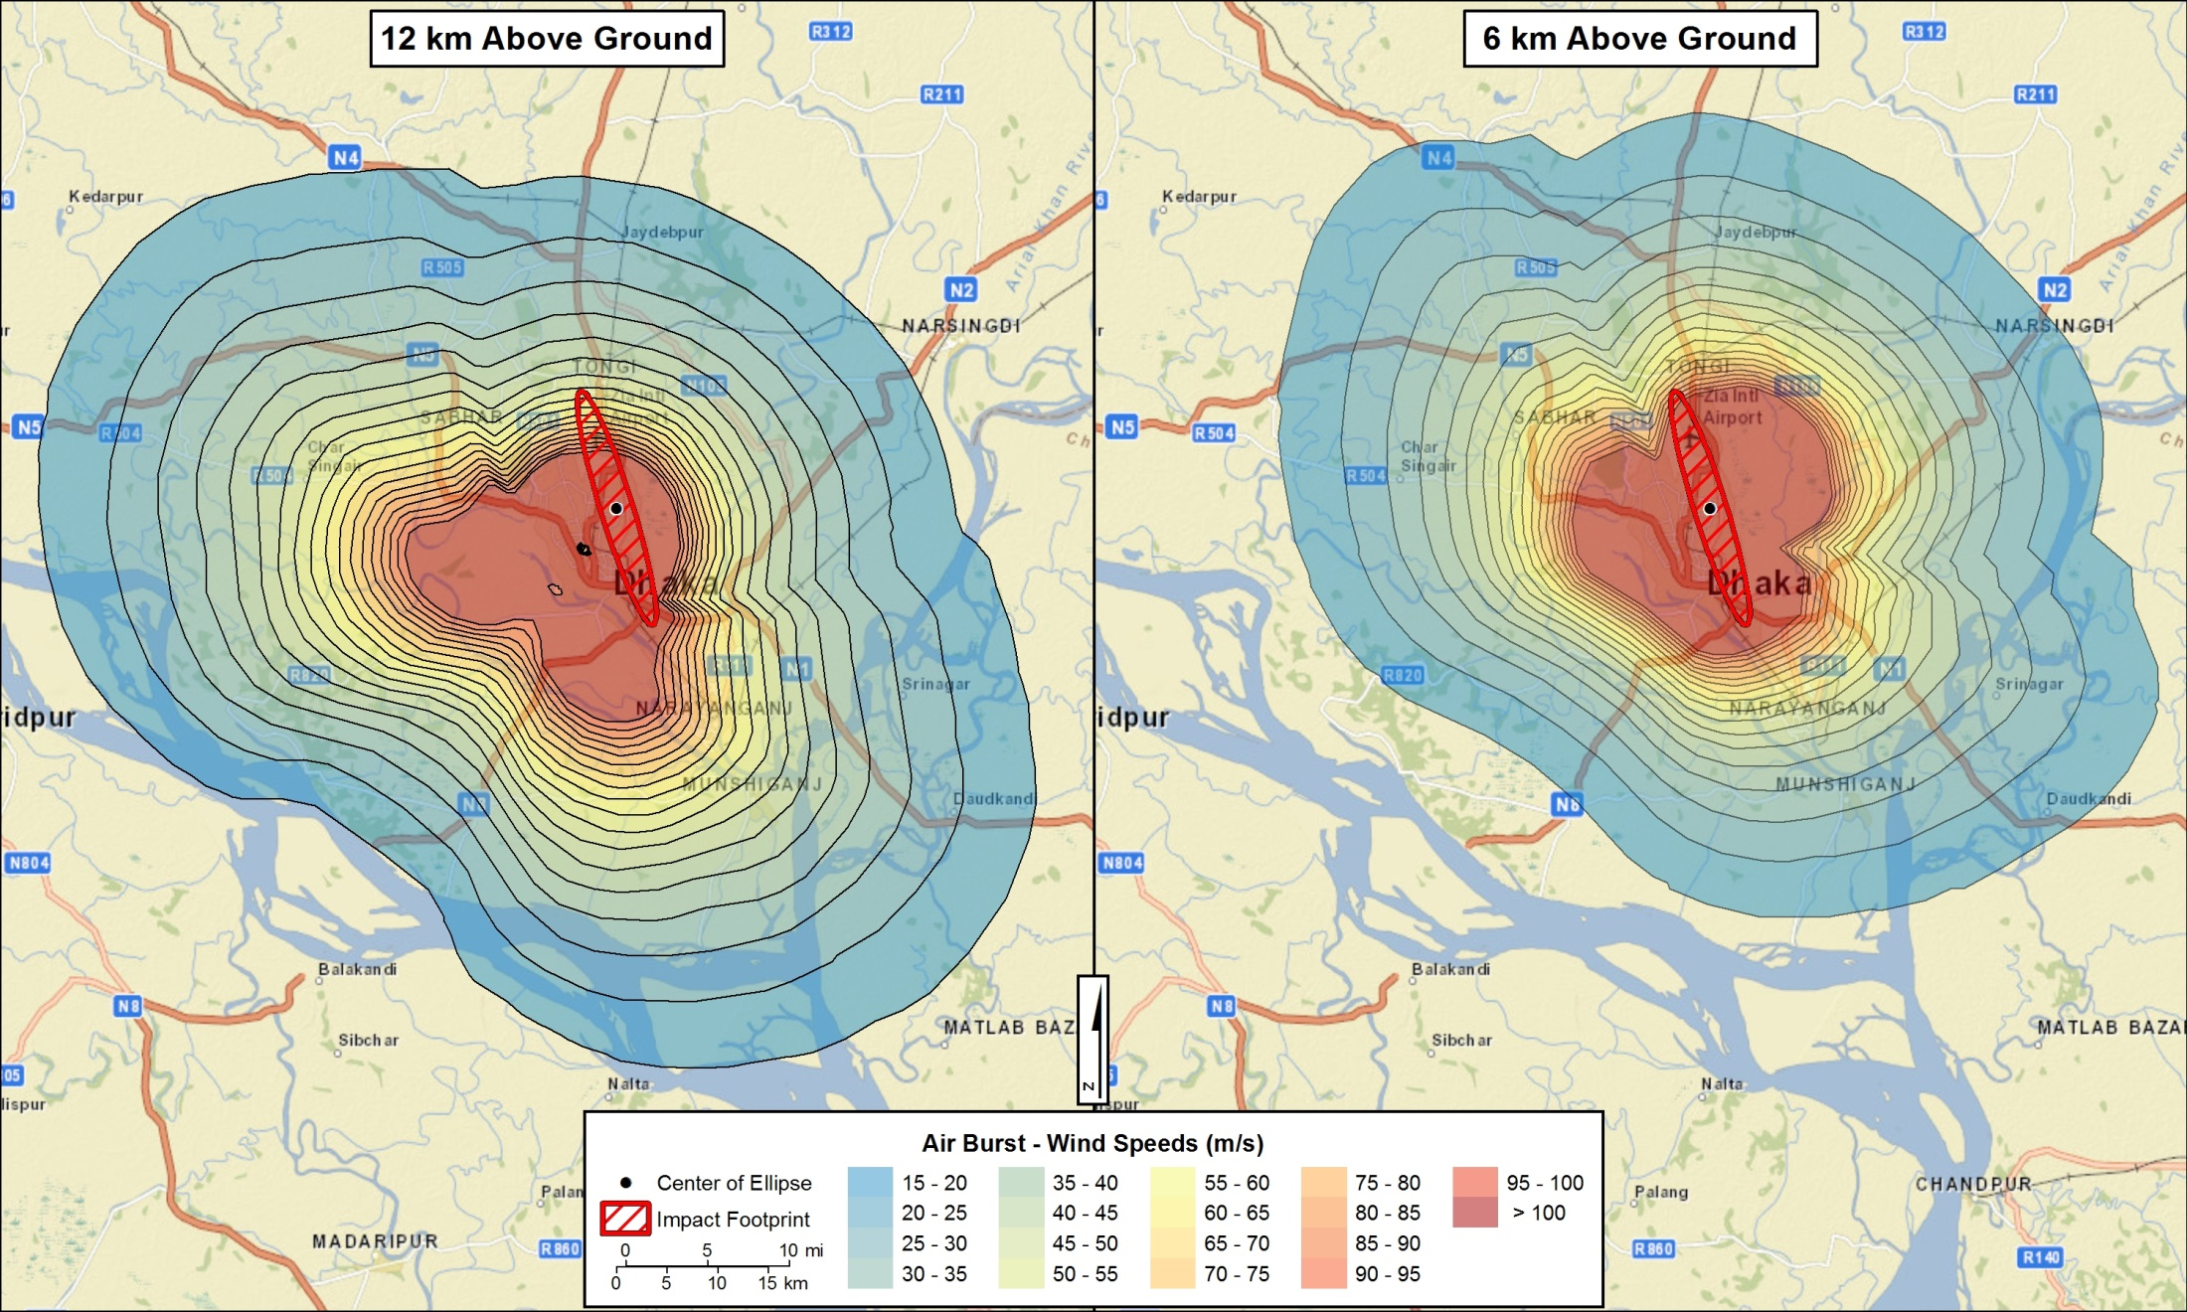
Wind maps for final footprint

Slide 5
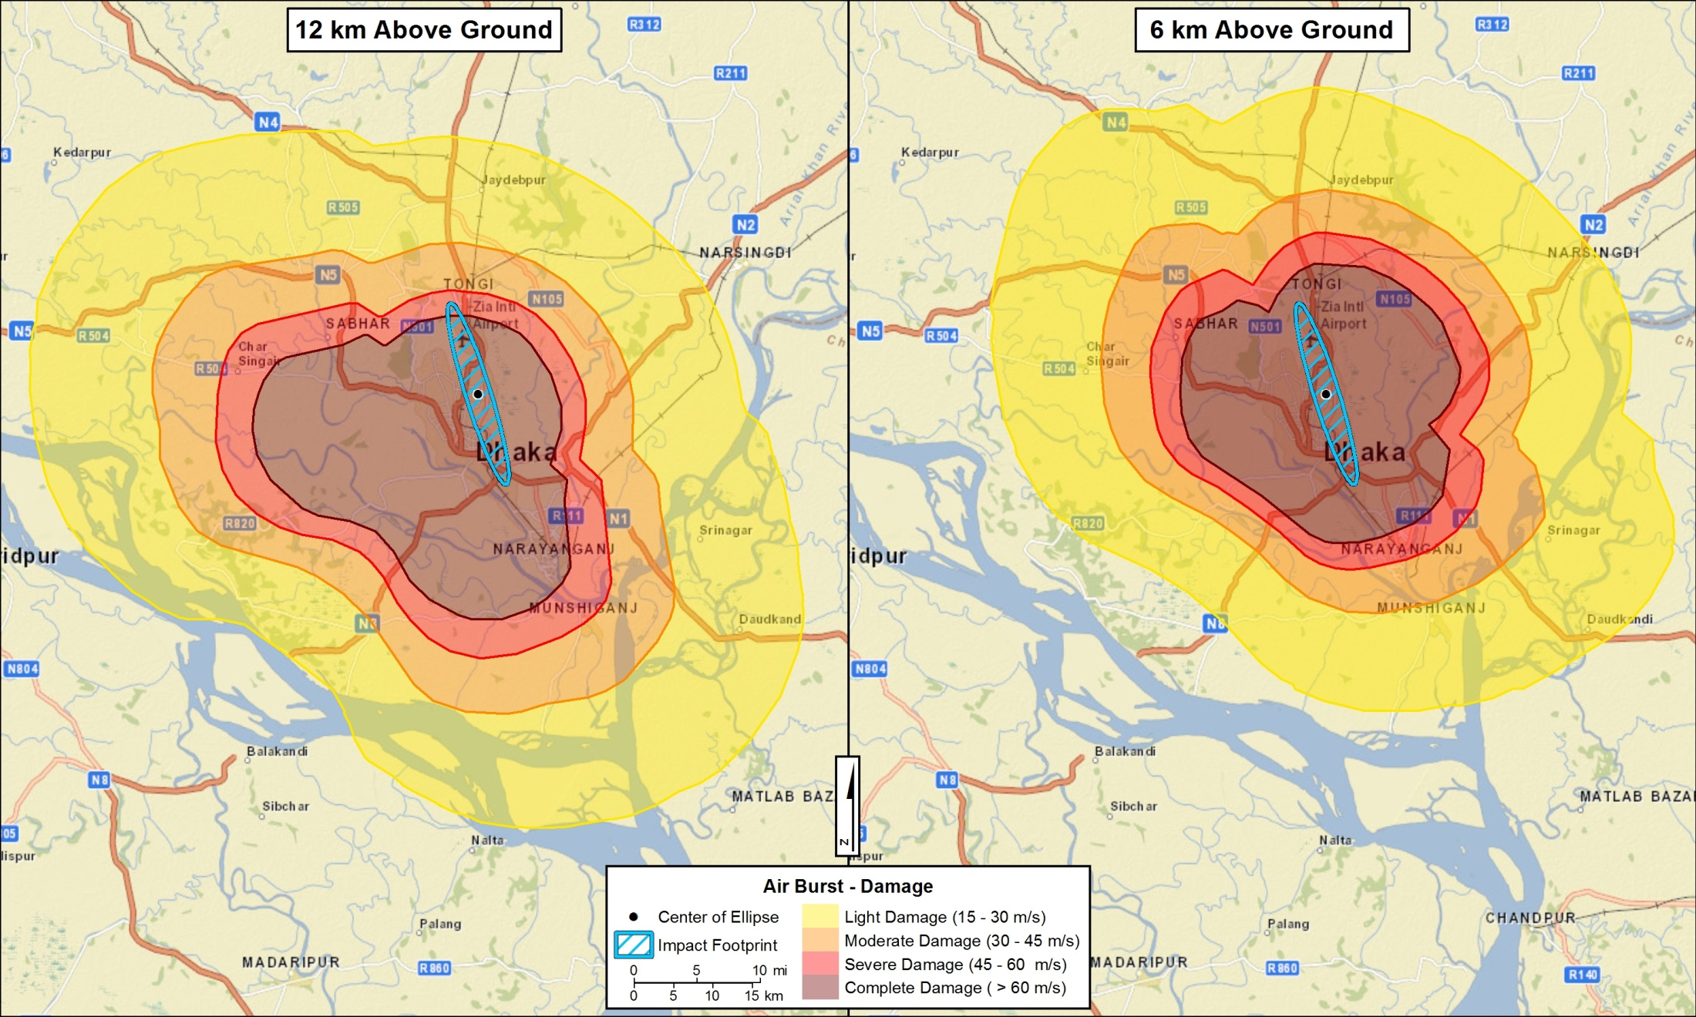
Damage maps for final footprint

Slide 6
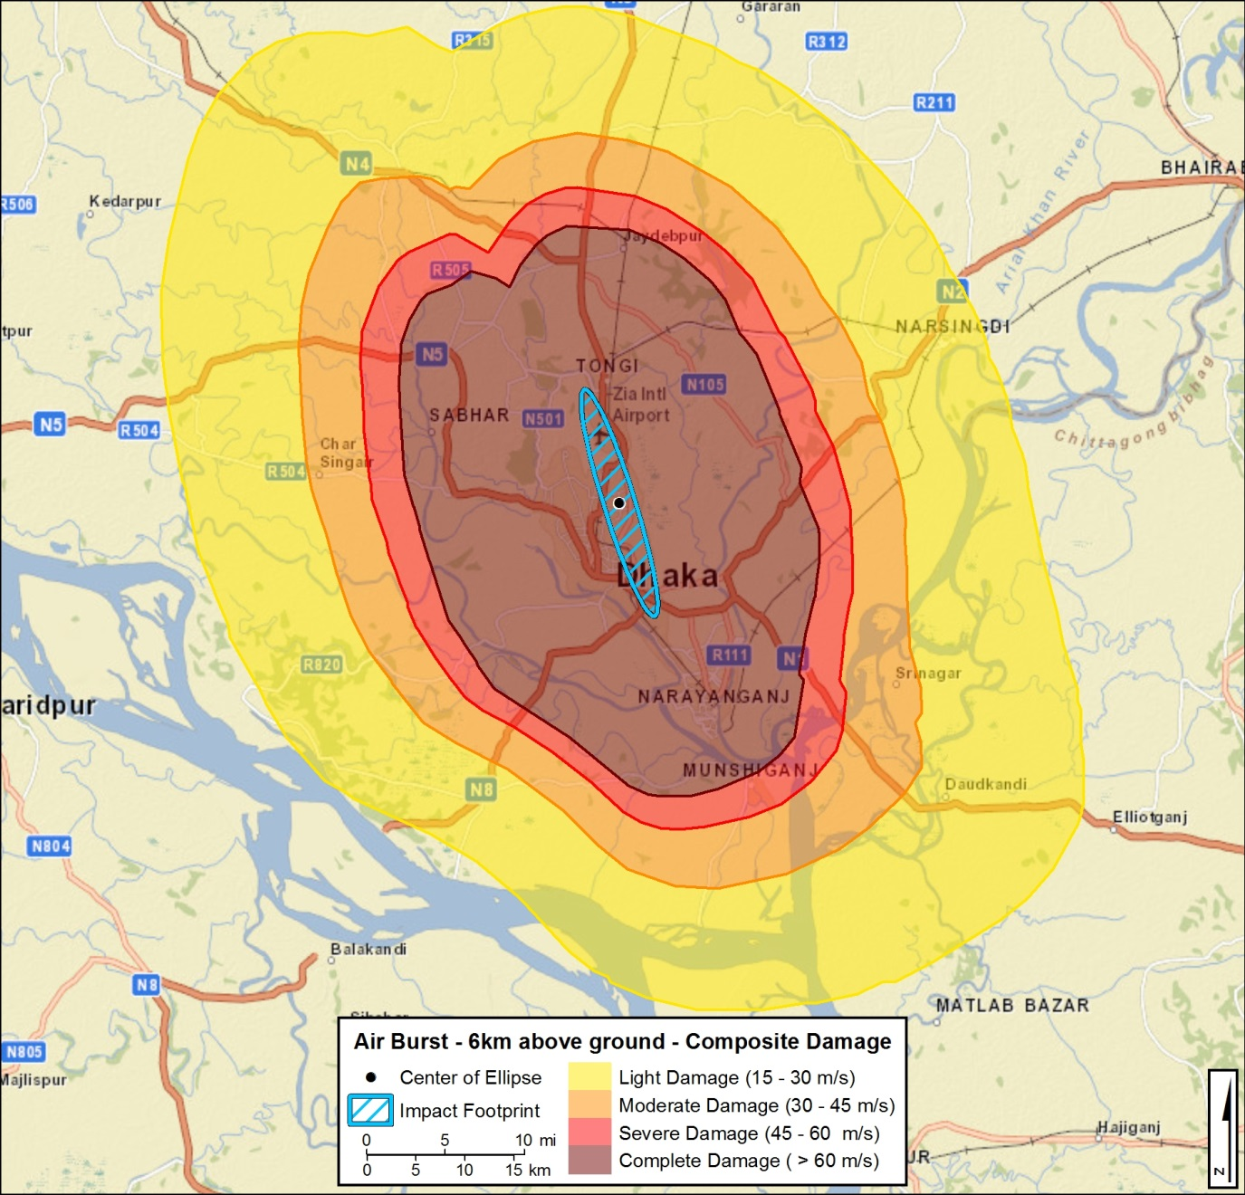
Composite damage map

Slide 7
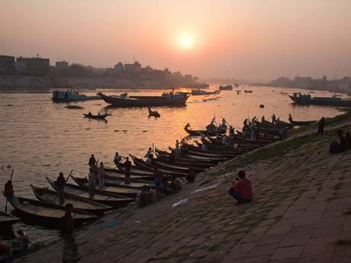
Nouka Dingi – Rowboat Taxis on the Buriganga River
http://www.independent.co.uk/travel/asia/bangladesh-travelling-from-buzzing-dhaka-to-the-bay-of-bengal-9820901.html

Slide 8
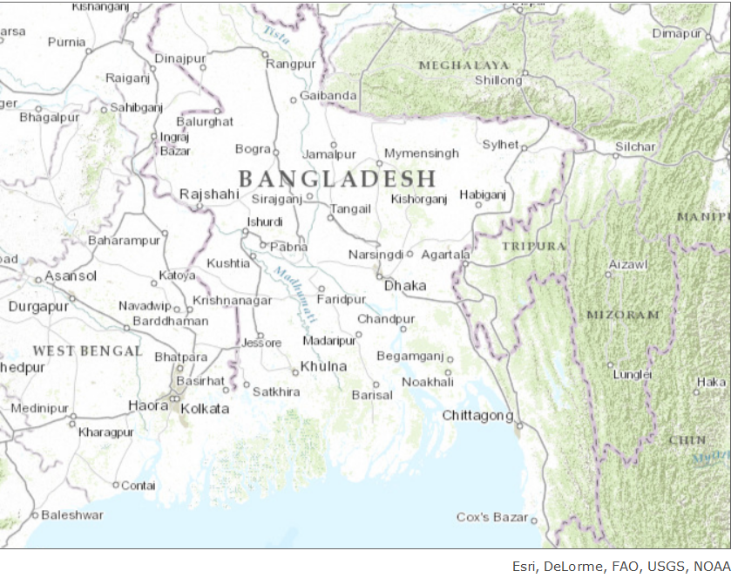
Dhaka, Bangladesh

Slide 9
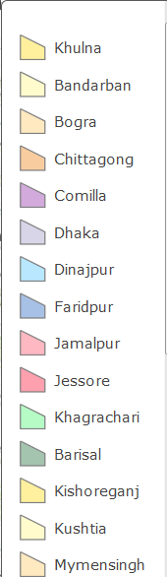
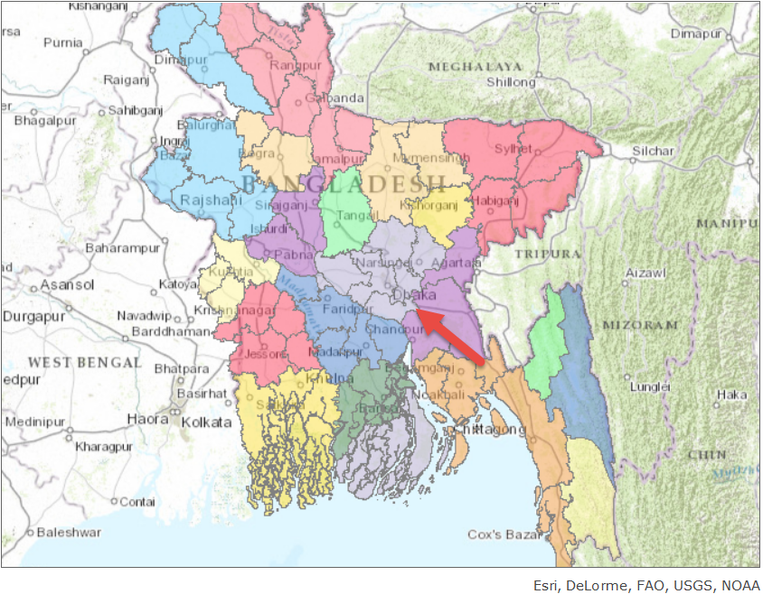
Bangladesh Districts
Local Governments

Slide 10
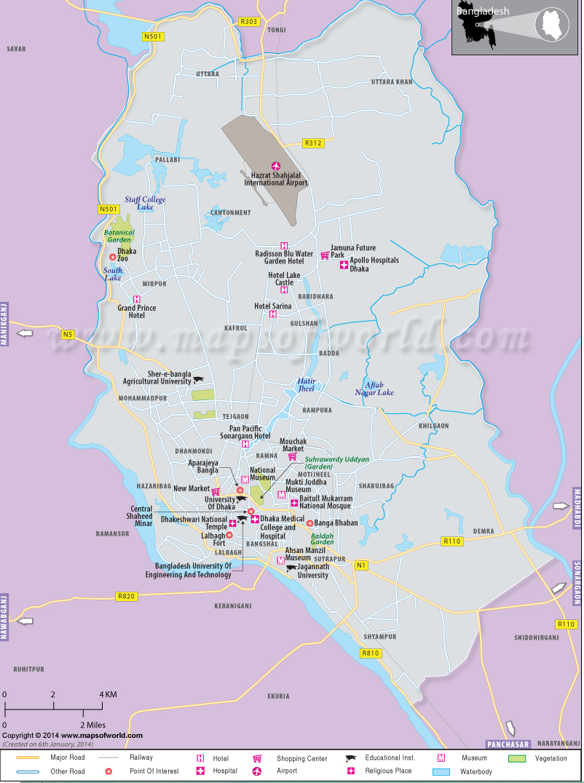
LANDMARKS, MONUMENTS, iNFRASTRUCTURE

Slide 11
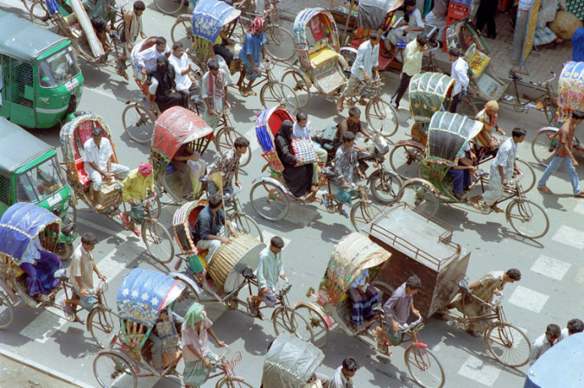
Dhaka Demographics
Capital of Bangladesh
Headquarters of the Dhaka Division and Dhaka District
Most populous city in Bangladesh and 10th largest city in the world
Population15M (Unofficial)
One of the largest Muslim (Sunni – small Shia community) Countries 80%/ 16% Hindu
28 Major Hospitals & Medical Centers
U.S. Ambassador – Marcia Stephens Bloom Bemicat
Delta region between two rivers Ganges and Brahmaputra
Known as the city of mosques
The only mega city in Bangladesh
Political economic and cultural heart of Bangladesh
One of the fasted growing metropolitan areas in the world
Major Transportation Dhaka Metro and Dhaka Elevated Expressway
Largest number of rickshaws in the world
Problems- congestion, poverty and overpopulation, over dependence on groundwater
University of Dhaka

Slide 12
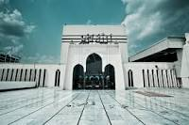
More Information - Holidays
Government – Dhaka City Corporation is self-governing corporation
  2 administrative parts: north and south each headed by an administrator
  Each incorporated area has several wards with elected commissioners.
Public schools
Home to numerous state and diplomatic establishments: the President of Bangladesh, National Parliament House, the Prime Minister, the Bangladesh Supreme Courts and the Dhaka High Court and the Foreign ministry and Defense Ministry
48 Embassies and high commissions and many international organizations
September 05 Krishna Janmashtami Holiday
Nearly 80% of annual rainfall between May and September(83.6 inches)
Average temperature 25°C
One of the worlds leading rice and jute growing regions
Industries include textiles, food processing and manufacturing
More that 700 mosques and historic buildings

Slide 13
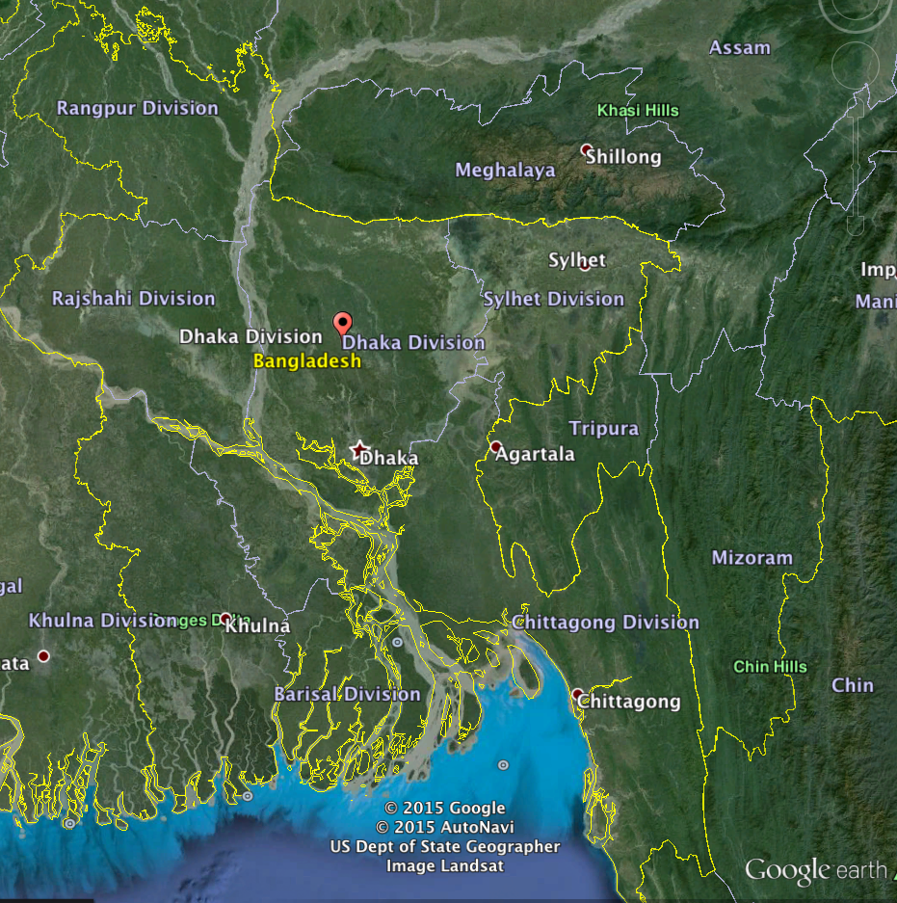
Dhaka Delta

Slide 14
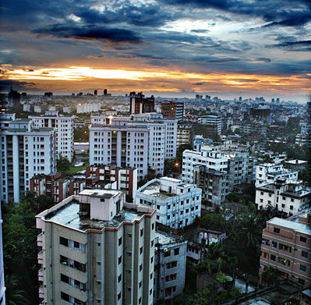
Modern High-rise Buildings in Dhaka
Dhaka population 7M
Greater Dhaka (conurbation) 15.5M
“Unplanned Mega-city”
Some of the largest shopping malls in the world
Dhaka is considered as a less economically developed country (LEDC)
http://wikitravel.org/en/Dhaka

Slide 15
Transportation
Shahjalal International Airport – located 11 miles (17 kilometers) from Dhaka largest airport in Bangladesh operated and maintained by the Civil Aviation Authority, used by the Bangladesh Air Force.
Bangladesh Railway – state owned; metre-gauge network
  Both intra-city and inter-city travel between Dhaka and Chittagong, Calcutta
Waterways
Rickshaw

Slide 16
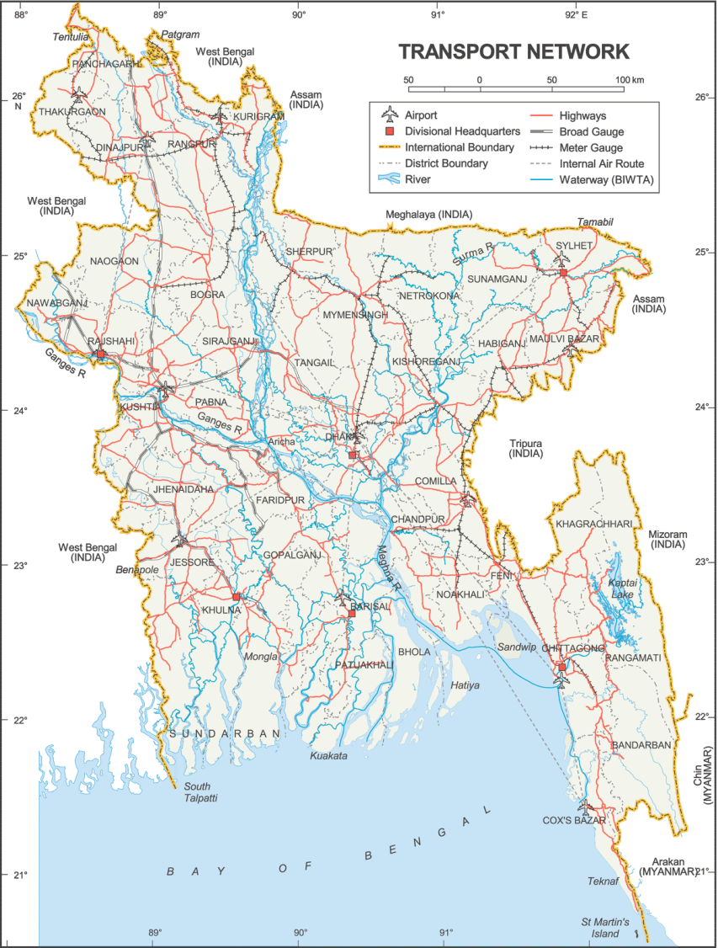

Slide 17
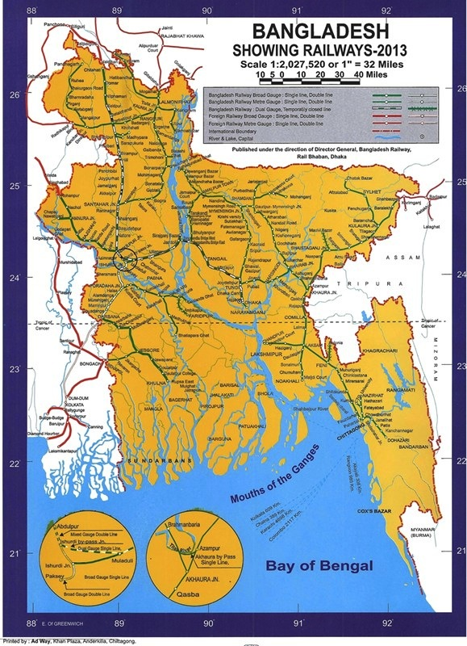

Slide 18
Utilities/Power
Bangladesh consumes approximately .1% of the total world consumption. Commercial consumption is about 50% of the total.
Most intensive use sectors transport( 50%) and industries (43%)
Natural Gas Use 66%
Oil
Hydropower
Coal
Proposed Nuclear Reactors– 2 1000 MWc (2012)

Slide 19
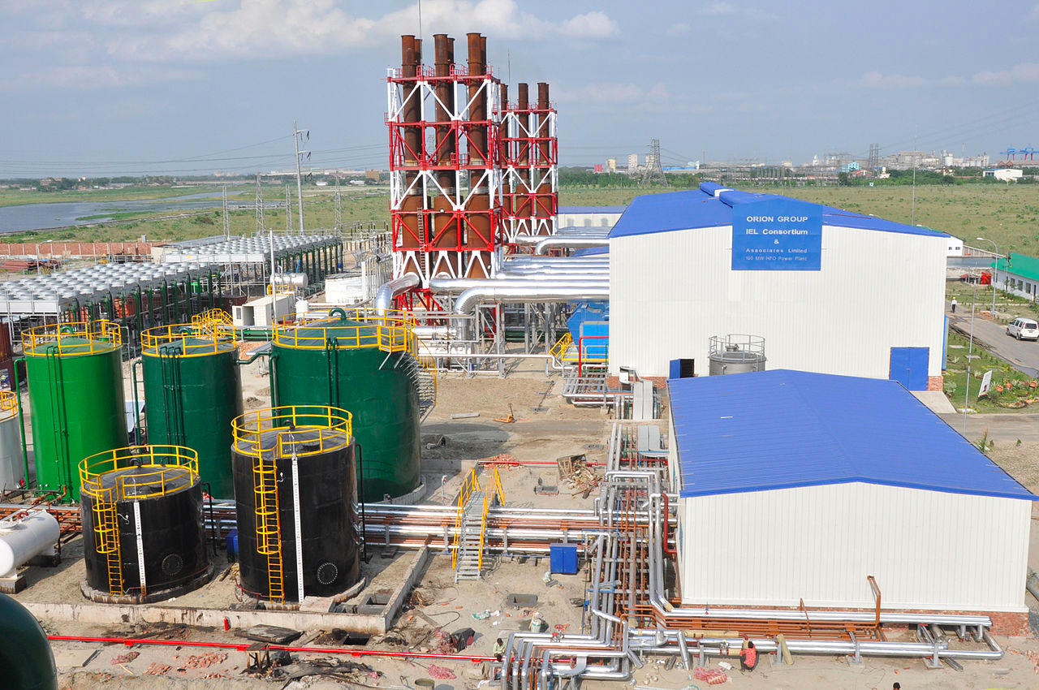
Power plant in Bangladesh
http://en.wikipedia.org/wiki/Electricity_sector_in_Bangladesh#/media/File:ORION_Group_constructed_two_100_MW_HFO_based_powerplant._in_due_time_and_is_supplying_the_national_grid..jpg

Slide 20
Bangladesh Electricity Regulatory Commission (BERC)
 | Number Circuit km | kVolt Lines
Transmission Lines | 1444 | 230 kV
 | 5255 | 132 kV
 | 6 nos | 230/132 kV
 | 63 nos | 132/33 kV
Distribution Lines | 164.70 | 400 kV
 | 3044.45 | 230 kV
 | 6210 | 132 kV
 | 1 nos | 400 kV
 | 18 nos | 230/132 kV
 | 88 nos | 132/33 kV
Power Production | 49 B kWh/day

Slide 21
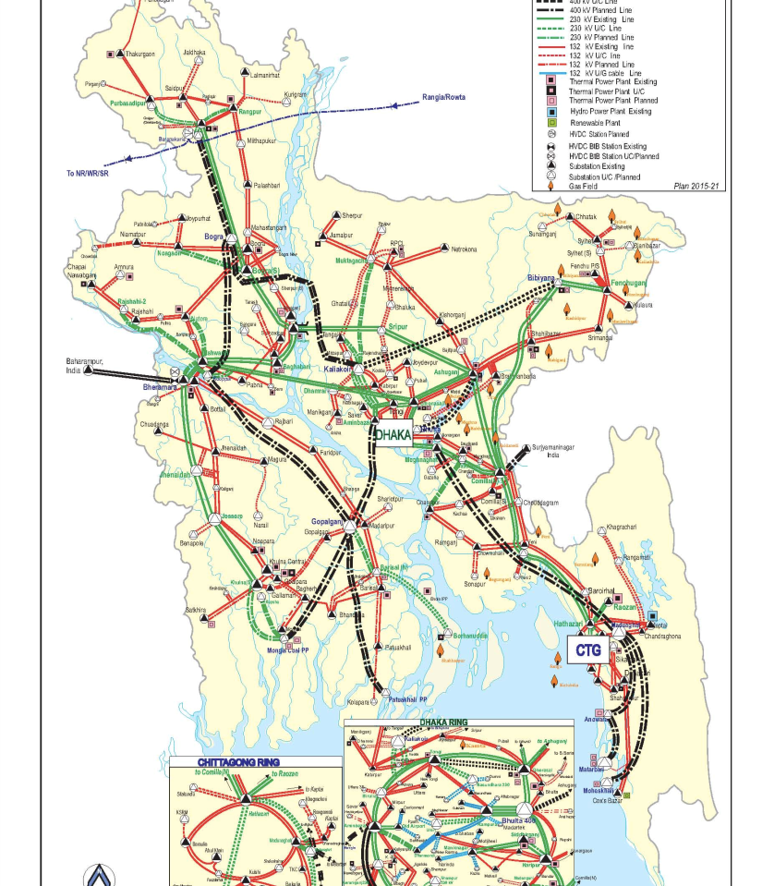
Electric
Transmission
Power Grid Company of Bangladesh (PGCB)
Maximum Generation 7418 MW
400 KV Substations 1 – 27.35 km line
230/123 KV Substations 18 – 1523.23 km line
132/33 /KV Substations 88 – 3505.55 km line

Slide 22
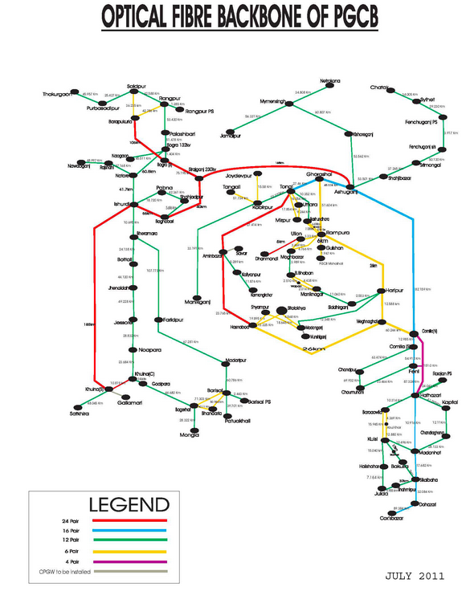

Slide 23
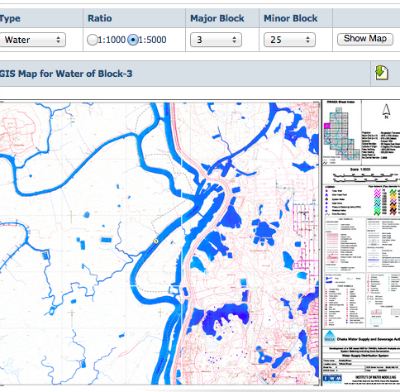
DWASA Water Supply and Sewerage Authority
In 2012 City required 2.2B liters of water per day
Official population 12.8M unofficial 15M 3-400,000 increase each year
Over-dependence on surface water
11 geographic zones, 10 in Dhaka
I office per zone

Slide 24
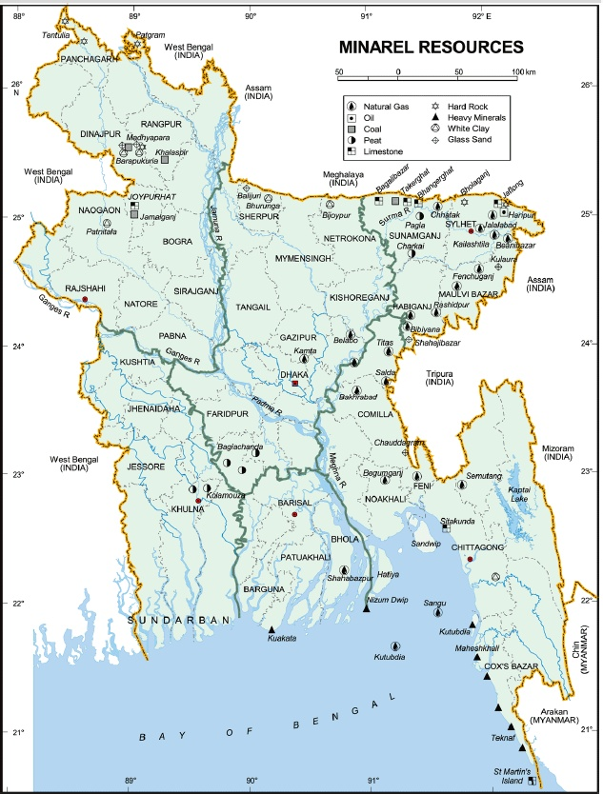
Natural Gas & Mineral Resources

Slide 25
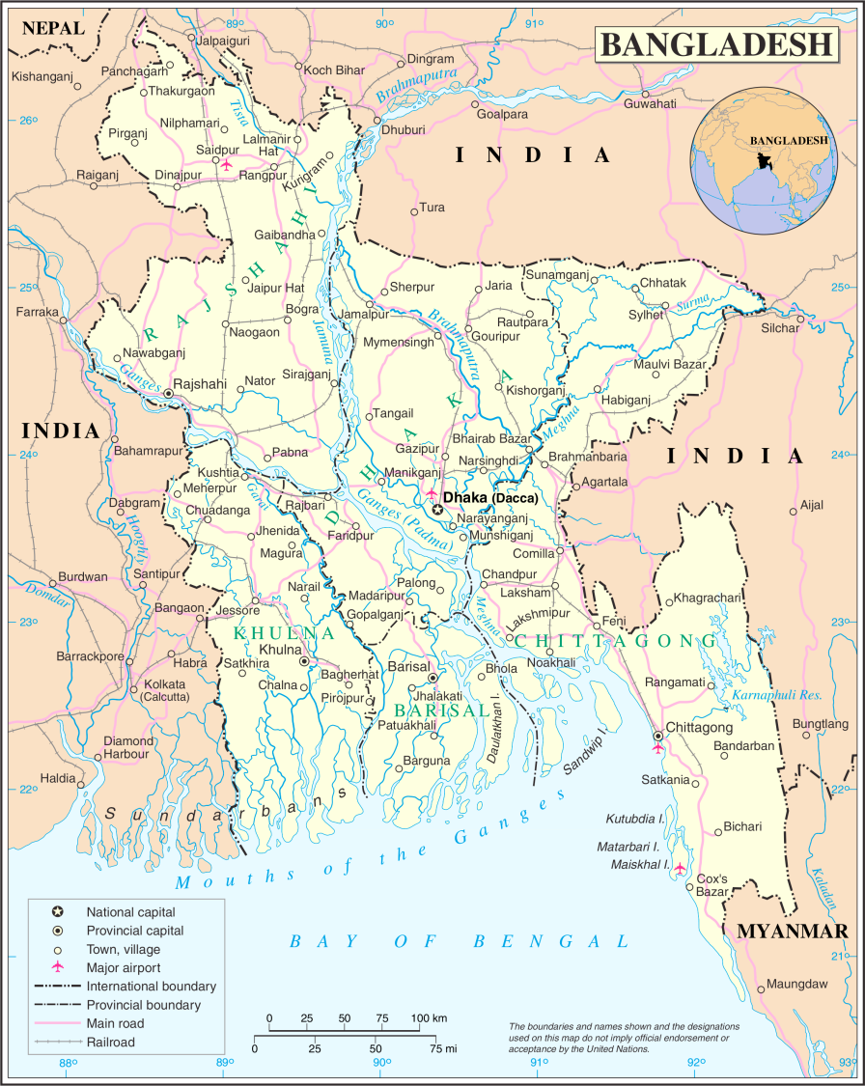

Slide 26
Resources
http://www.usea.org/sites/default/files/event-file/493/overviewofbpdb.pdf
https://energypedia.info/wiki/Bangladesh_Energy_Situation#Introduction
http://www.petrobangla.org.bd/photo_gallery.php

